Slide 1

Decolonizing survey
Reflections on constructing and conducting a community-oriented, art-based approach to investigate and enhance children's critical cultural literacy
Rikke Brown¹, Livia Lund Ejdesgaard², Gro Hellesdatter Jacobsen²,
Søren Sindberg Jensen ², Karoline Lund Nielsen ² & Pernille Welent Sørensen ¹
¹Professionshøjskolen Absalon; ¹SDU (University of Southern Denmark, Denmark); ³AAU (Aalborg University),
Community-Based Research, Decolonial Theory and Education
Challenges and Opportunities
June 5, 2025

Slide 2
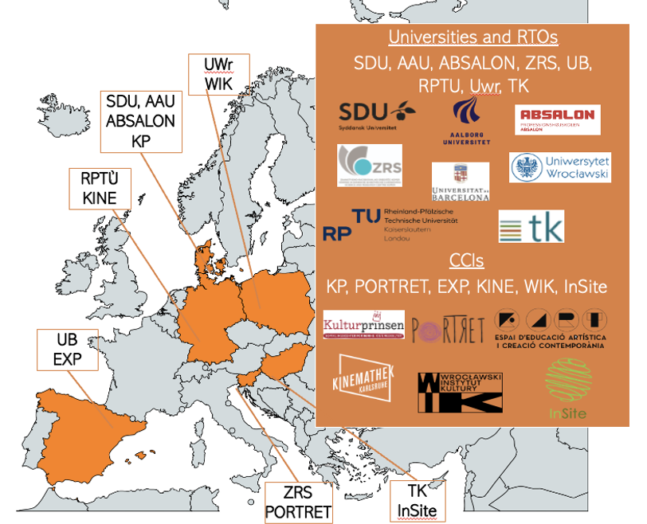
(EXPloring and Educating Cultural literacy Through Art)
Project period: 2024-2026
Coordinator: SYDDANSK UNIVERSITET (SDU)
Call: HORIZON-CL2-2023-HERITAGE-01: Research and innovation on cultural heritage and CCIs – 202​
Topic: HORIZON-CL2-2023-HERITAGE-01-07: Promoting cultural literacy through arts education to foster social inclusion​
Grant agreement no: 101132662
https://www.expectart.eu/

Slide 3
RQ
How can surveys be decolinized in a community-oriented project in a school-setting?
Which obstacles arise when the ethical and theoretical
ideals meet the practical realities?

Slide 4
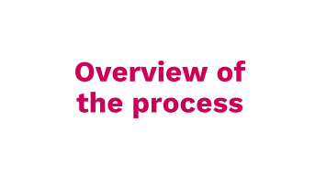
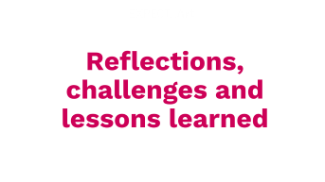


Notes:
To answer these questions, we will address these points:
First I will elaborate on the background
Then Livia will give us an overview of the ongoing process of developing a decolonoed survey tool
Then we will highlight important themes in the process and round off with reflections, challenges and lessons learned

Slide 5
Background
Notes:
Søren

Slide 6
Background
Why decelonize survey methodlogies?
Surveys and sociology are part of part of a Western-centric understanding of knowledge production that neglect marginalized voices
“Sociological theories (…) reproduce a “colonial episteme” by portraying theories developed in and about the west as universally true (Grosfoguel 2013) and relying on oppositional dichotomies that describes the “west” as the hub of progress, rationality, civilization, innovation, and sophistication and colonized populations as inferior, primitive, savage, and under-developed.” (Fahlberg 2023, p. 98)
When doing research with a decolonial point of departure, it affects all dimensions of data generation and no methods can be left untouched
“Importantly, we argue that decoloniality praxis has been relegated to the margins of qualitative and participatory methods. As such, experimental and quantitative designs seem to have eschewed the requirements of positionality and critical reflexivity. We resist this essentializing of methodology that positions quantitative paradigms as impermeable to reflexivity and decoloniality.” (Singh et al, 2018, p. 386)
Notes:
Søren
Surveys are considered a prime example of a data generation method that contributes to western centric knowledge production. So when in the EXPECT_Art project we need to account for this and find ways to decolonise the survey method, when using it
In this respect we draw on literature arguing that surveys are not any different other methods in that they can and should be subject to critical reflexcivity.

Slide 7
Background
How to decelonize survey methodologies?
Decolonicing survey methodologies implies acknowledging vast differences among research participants
” Decolonizing sociology thus requires that researchers recognize this heterogeneity and create mechanisms for uniquely marginalized individuals, particularly those outside the academy, to have their literal voices heard (rather than abstract representations of these voices) in the everyday practices of research collection, analysis and dissemination.” (Fahlberg 2023, p. 100)
Decolonizing survey methodologies requires on-going comprehensive collaborative (meta)reflectivity
“…we encourage data collectors to engage in critical thought about decolonizing with regard to research generation, design, analysis, and interpretation.” (Singh et al, 2018, p. 388)
Notes:
Søren
So, in order to start developing a way of doing survey’s – we have drawn on literature arguing that in order to decolonizing surveys we need to address acknowledge the fact that research participants are wastly different
Further, more we’ve been tried to take seriuously, that to decelonizing surveys, requires on-going comprehensive collaborative metareflexivity.
To quote Singh et al, 2018:
“…we encourage data collectors to engage in critical thought about decolonizing with regard to research generation, design, analysis, and interpretation.”
So in the next part of the presentation we invite you into our process.

Slide 8
Overview of the process
Notes:
Søren

Slide 9
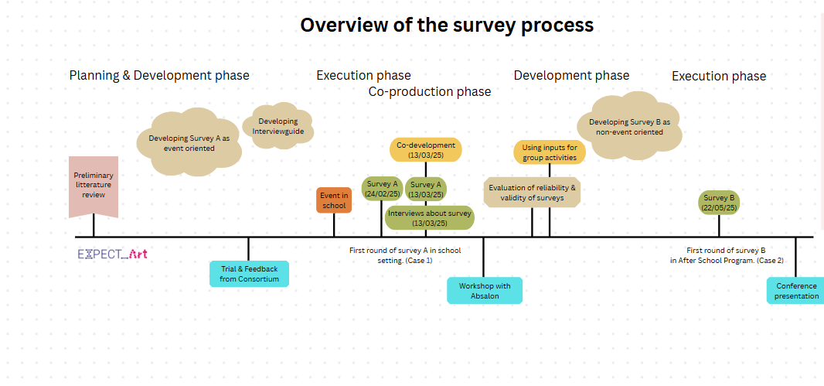

Overview of process
INTERVIEWS
ABOUT SURVEY
SURVEY
CO-DEVELOPMENT OF SURVEY
EVENTS IN SCHOOL
EVALUATION
SURVEY DEVELOPMENT
SURVEY DEVELOPMENT
Consortium co-learning,
Workshop at Absalon,
Now: Conference presentation!
SURVEY
LITTERATURE REVIEW
Notes:
Livia.
Vise de andres spor også. Med udgangspunkt I det danske.
Vise med animation at vi er ved conference paper nu, og at det derved er ongoing.

Slide 10
Themes
Notes:
Søren

Slide 11
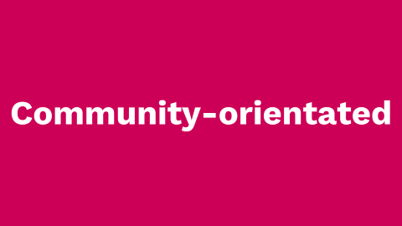


Themes
Notes:
Livia står for overgangen, med præsentere de tre temaer.
Ca. 10 minutter I alt
Pkt. 1. Søren
Pkt. 2. Rikke
Pkt. 3. Livia

Slide 12
Decoloniality
Notes:
Livia står for overgangen, med præsentere de tre temaer.
Ca. 10 minutter I alt
Pkt. 1. Søren
Pkt. 2. Rikke
Pkt. 3. Livia

Slide 13
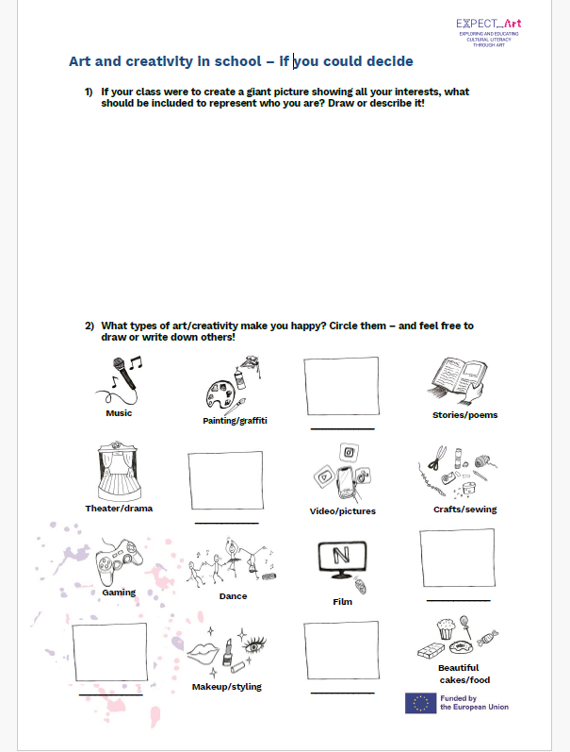
Themes: Decoloniality
Data generation and analyzis
Welcome children’s engagement and disruptions
Cater to different interests and (dis)likes of children
However, in the EXPECT_Art project research aims had to be well-defined before meeting participants
Survey subordinated the ethnographic case methodology
  Surveys as yet another form of expression for participants
  The data adds to the thick decription (Geertz, 1973) of the case, that we want to collaboratively to generate
Does not allow for systematic generation of numeric data and graphs
Notes:
In addressing the theme of decoloniality of in the development of surveys have reflected upon

Slide 14
Community-orientated
Notes:
Livia står for overgangen, med præsentere de tre temaer.
Ca. 10 minutter I alt
Pkt. 1. Søren
Pkt. 2. Rikke
Pkt. 3. Livia

Slide 15
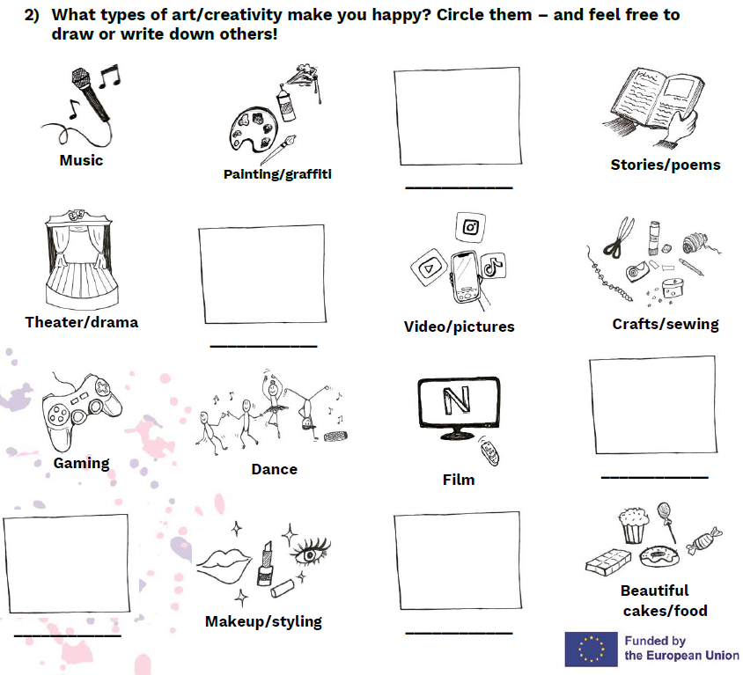
Themes: Community-oriented
Children in the local communities are encouraged to suggest changes to the survey in a follow-up interview (encouraged to cut, glue, write, and draw on a blank version of the survey).
Space has been provided for drawing or writing alternative response categories beyond the examples we have included, e.g., in relation to cultural expressions/activities.
Local researchers can use the full survey or select
individual questions and are encouraged to adapt
it to the cultural expressions they encounter
among the children locally.
We do not aim to create a finalized, context-
independent survey. Instead, we see the survey
as continuously co-developed with children in each
local context.
Notes:
Livia står for overgangen, med præsentere de tre temaer.
Ca. 10 minutter I alt
Pkt. 1. Søren
Pkt. 2. Rikke
Pkt. 3. Livia

Slide 16
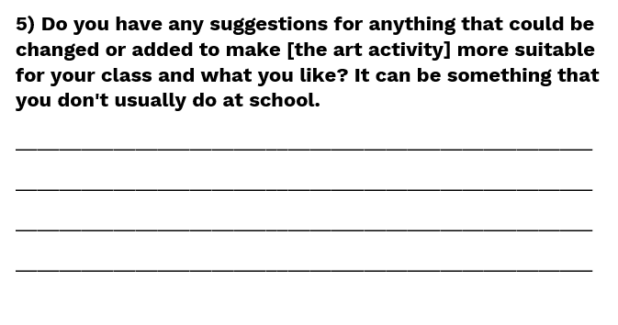
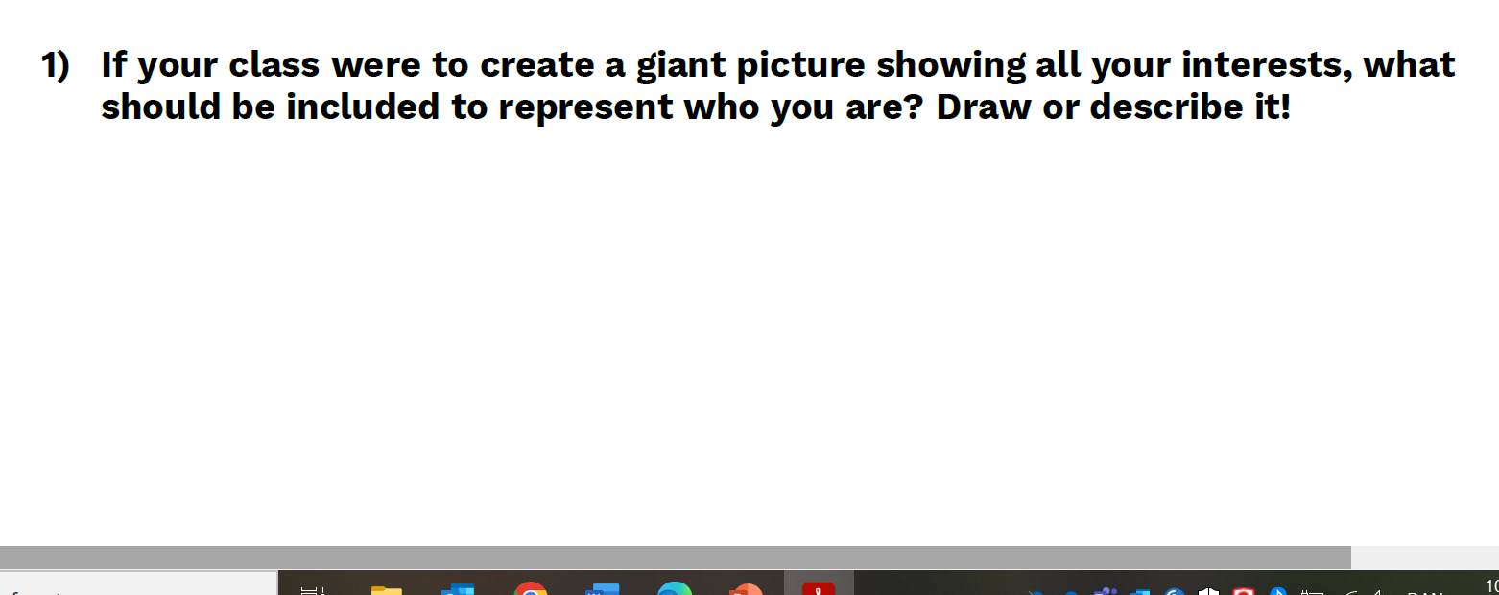
Themes: Community-oriented
We aim to approach cultural literacy as something emerging and embedded in the local community, rather than as an inherent individual competence or material possessions
    By encouraging the children to complete the survey together, if they wish.
    By asking about “what makes you happy” instead of whether they have, e.g., musical instruments or artworks at home.
    And by asking about the class rather than the individual child.
Notes:
Livia står for overgangen, med præsentere de tre temaer.
Ca. 10 minutter I alt
Pkt. 1. Søren
Pkt. 2. Rikke
Pkt. 3. Livia

Slide 17
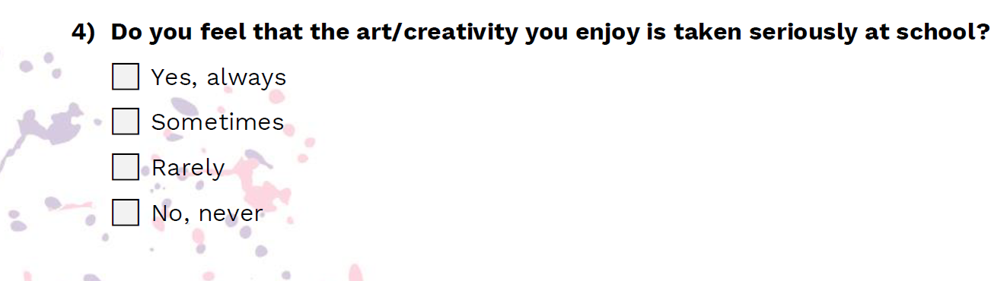
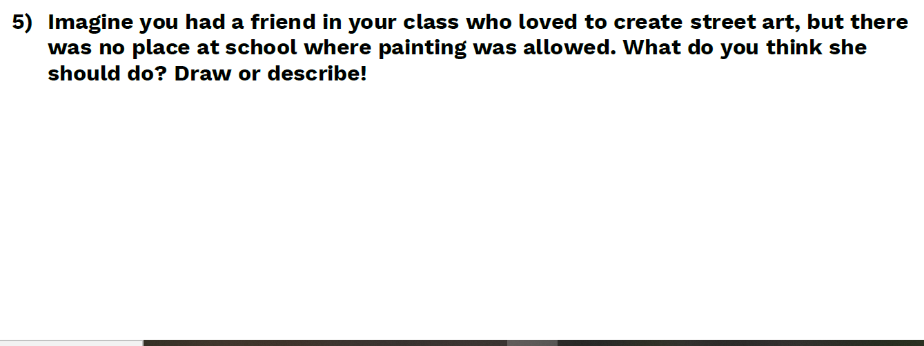

Themes: Community-oriented
We seek to make the survey an opportunity to express otherwise unrecognized or marginalized cultural expressions that children value — and perhaps even a means to foster critical cultural literacy among them.
Notes:
Livia står for overgangen, med præsentere de tre temaer.
Ca. 10 minutter I alt
Pkt. 1. Søren
Pkt. 2. Rikke
Pkt. 3. Livia

Slide 18
Arts-based
Notes:
Livia står for overgangen, med præsentere de tre temaer.
Ca. 10 minutter I alt
Pkt. 1. Søren
Pkt. 2. Rikke
Pkt. 3. Livia

Slide 19
Themes: Arts-based
Notes:
Livia står for overgangen, med præsentere de tre temaer.
Ca. 10 minutter I alt
Pkt. 1. Søren
Pkt. 2. Rikke
Pkt. 3. Livia
Using visual expressions, art-based methods and drawing-options. As mentioned by Goopy & Kassan 2019 there are great benefits in using arts-based methods, as it is “…one of the most effective ways that researchers can shift beyond traditional power relationships in research is to shift their approach to research beyond language.” (Goopy and Kassan, 2019, p. 4). Here we have discussed in what ways it would be possible for us to adapt/alter the traditional survey approach, which has many colonial connections, and by integrating art-based methods, moving beyond language, thereby shifting power dynamics and opening up for new modes of expression.

Slide 20
Reflections, challenges and lessons learned
Notes:
Søren

Slide 21
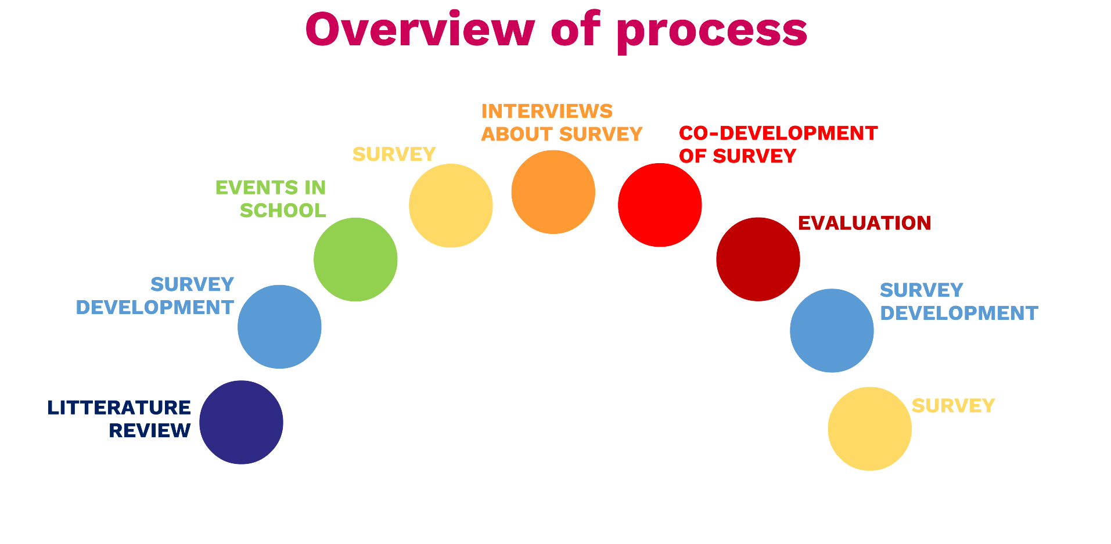
Reflections, challenges and lessons learned
With the presented survey formats we – together with many others – move beyond the subject-object-constellation towards a subject-subject-constellation where data is rather generated (Anderson & Irvine, 1993) than “collected”.
Quality criteria connected to critical ethnography for instance critical reflection (Anderson & Irvine, 1993) are promoted at the expense of quantitative quality criteria such as validity and reliability
  E.g. richness, sensitivity to context, transferability and impact, and ethics (Cena et. al, 2024)
The survey formats presented is one way of decolonizing surveys – cf. Fahlberg (2023) for decolonization of a more ”traditional” survey format
The research design of the EXPECT_Art project limits the extend to which the survey formats and procedures are decolonial and community-based
Decolonization is an ongoing process (Singh et al, 2018; Dei, 2016); the
presented survey formats and the collaborative process, which lying
behind them are a minor contribution to that process.
This presentation is part of the process – we are looking forward to
your questions and comments!
Notes:
Læg op til spørgsmål. Vise at præsentationen er en del af processen, som udgangspunkt for netop at inddrage dem.
Alle byder ind med spg. Løbende.
Rikke fortæller.
Ri

Slide 22
References
Cena, E., Brooks, J., Day, W., Goodman, S., Rousaki, A., Ruby-Granger, V., & Seymour-Smith, S. (2024). Quality Criteria: General and Specific Guidelines for Qualitative Approaches in Psychology Research. A Concise Guide for Novice Researchers and Reviewers. International Journal of Qualitative Methods, 23. https://doi.org/10.1177/16094069241282843
Boyd, M. R. (2020). Community-based research: Understanding the principles, practices, challenges, and rationale. In P. Leavy (Ed.), The Oxford handbook of qualitative research (pp. 498–517). Oxford University Press.
Dei, G. (2016). Decolonizing the university: The challenges and possibilities of inclusive education. Socialist Studies/Études Socialistes, 11(1), 23-23.
Fahlberg, A. (2022). Decolonizing Sociology Through Collaboration, Co‐Learning and Action: A Case for Participatory Action Research 1. Sociological Forum, 38. https://doi.org/10.1111/socf.12867.
Geertz C (1973) The Interpretation of Culture: Selected Essays. New York: Basic Books.
Mignolo, W. D. (2009). Epistemic disobedience, independent thought and decolonial freedom. Theory, culture & society, 26(7-8), 159–181.
Singh, S., Granski, M., Victoria, M. D. P., & Javdani, S. (2018). The praxis of decoloniality in researcher training and community‐based data collection. American journal of community psychology, 62(3-4), 385-395 https://doi.org/10.1002/ajcp.12294

