Slide 1


CREATING INCLUSIVE SPACES:
APPLYING ART-BASED RESEARCH WITH CHILDREN IN SLOVENIA
Maja Zadel, Zorana Medarić, Lucija Dežan & Sandra Končan
Science and Research Centre Koper
Community-Based Research, Decolonial Theory and Education
Challenges and Opportunities
Budapest, June 5, 2025

Slide 2
Introduction
Aim of the presentation: to present the initial phases of art-based research in Slovenian elementary schools
Guiding questions:
Q1: How can pupils become co-producers of knowledge about topics that concern them through art-based approaches?
Q2: How do we address children‘s interests and identities within a decolonial framework that critiques globalising influences?
EXPECT_Art project (January 2024-December 2026)

Slide 3
Community-Based Research
„Community-Based Research (CRB), aims “to connect academic researchers with individuals, groups, and community organizations to collaborate on a research project to solve community-identified and community-defined problems” (Boyd 2014, p. 501), which in return aids researchers in offering the best opportunities for research participants to be recognised and listened to.„ (DoA, 2024, p.7)

Slide 4
Art-Based Research
Arts-based research can be defined as research that “involves adapting the tenets of the creative arts to research projects.” (Alanen, Baraldi, de Coninck-Smith, Laoire, & Tisdall, 2018, p. 206 in Jensen and Hellesdatter Jacobsen, 2025).
Children create (express) knowledge in the process of research through drawing, painting, photography, creating videos, role-playing, acting etc.

Slide 5
Art-Based Research
Different arts-based methods may enhance children‘s agency and foster their own particular ways of expression – hearing their voices (James et al., 1998) as the children decide for themselves “how to represent their worlds to themselves and others” (White et al., 2010, p. 144).
In addition – said to be more familiar and enjoyable for children, as they are based on activities that they usually like to do (e.g. drawing, mapping, photographing, recording, using phones, tablets) (Moskal, 2010).
Supposed to help empower children or bring about changes in their favour (Mitchell, 2006, pp. 61–62).

Slide 6
Culture
British cultural studies
= A dynamic, everyday practice where meanings are created, shared, and contested within power structures—encompassing everything from art and media to social rituals and group identities
Stuart Hall (1997):
“Cultural turn”: emphasis to the importance of meaning to the definition of culture → Culture ≠ not a thing or a set of things (TV programme, novel, painting …)
but A PROCESS, a SET OF PRACTICES.
“Things in themselves do not have meaning”, Hall, 1997, 2.
Raymond Williams (1989 [1958]):
Culture is ordinary. Every human society has its own shape, its own purpose, its own meanings. Every human society expresses these, in institutions, and in arts and learning. The making of a society is the finding of common meanings and directions […]

Slide 7
Culture 2
“Culture is concerned with the production and exchange of meanings”
Belonging to the same culture = to “interpret the world in roughly the same way [common language and common mental maps] and can express themselves, their thoughts and feelings about the world, in a way which will be understood by each other” (Hall, 1997, 2)
Marie Gillespie (1995): RE-CREATIVE CONSUMPTION
→ media consumers create their own meanings that shape them with images and meanings that circulate in the media

Slide 8
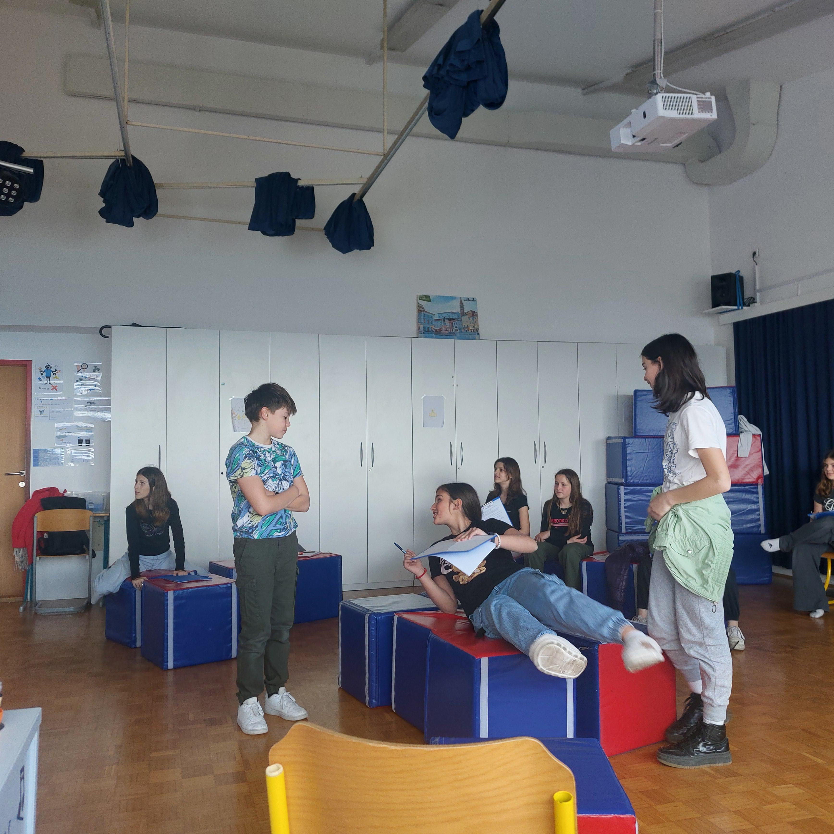
Theatre clubs
Two theatre clubs:
Maribor and
Koper - lasting several months, ongoing
Implemented by artistic partner Portret
Children aged between 10 and 15
Collaborative development of school plays – from topic selection to performance
Photo: Maja Zadel

Slide 9
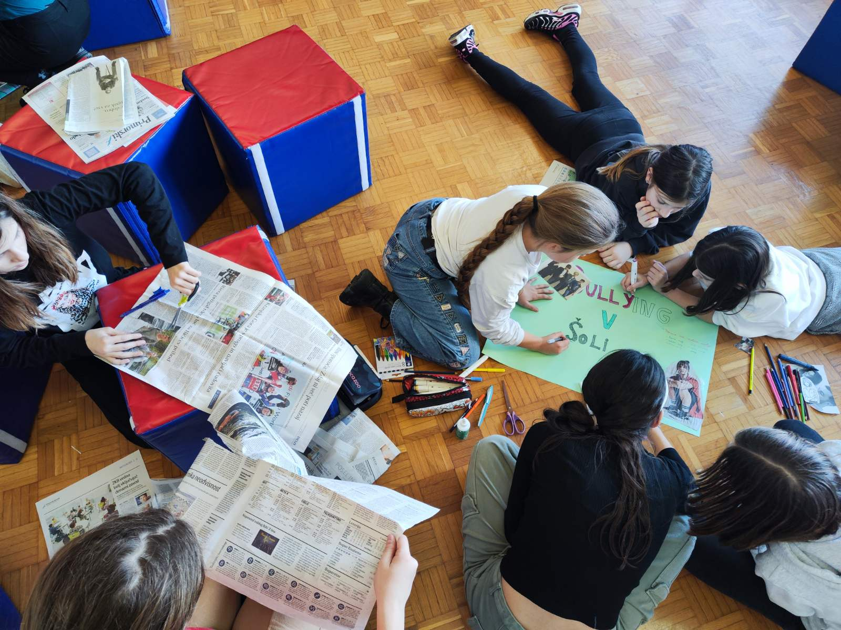
Q1: Children as co-producers of knowledge and ABM enhancing their participation and expression
Topic selection – use of drawing and mapping, discussion, cutting and pasting from magazines – in groups
Discussions with children: a place to socialise, play, express their voices, interests, identities
Observations: Art-based activities as enjoyable, spontaneous (& bodily)
Photo: Tina Rataj

Slide 10
Reflections
Art-based methods alone do not equal involvement or participation –considering issues of power and asymmetrical power relations (Jensen and Hellesdatter Jacobsen, 2025)
Children express cultural literacy and self-organise in the process. Some more active role, some prefer to assist in different ways. Some children may not feel seen or heard. Whose voices are being heard? Some children disengaged or dropped out. Adult`s role?
Spatial aspects: activities conducted within institutional settings (schools) significantly shaped by the established rules and power structures (researched referred as „teachers“) – nevertheless trying to create spaces for creativity

Slide 11
Q2: Addressing children‘s identities and interests
Topics related to violence (horror story, crime story, bullying) - their own way of expression: through pop culture, crime series, action movies
→ The children show what matters in their own cultural universe – their cultural literacy enhancing their agency
→ The children‘s cultural language form their cultural world
→ What is important to children? Horror/crime
As adults we try respecting their cultural knowledge, trying to de-centre our adult authority – avoid interpreting children‘s expression through our lenses – their cultural references– even if commercial or popular (and from our perspective colonial) → re-creative consumption?
?
--> Humour?

Slide 12
Reflections
The interpretations & assumptions
Talking and discussing with children is important part of the process
→ To better understanding of their voices, addressing their interests and identities
Continuous reflexivity of our own work (views, positions) – enables (at least small) changes in our research process and understanding of children‘s voices
→ Complex process – we must be aware of the complexity
→ Ongoing learning process

Slide 13
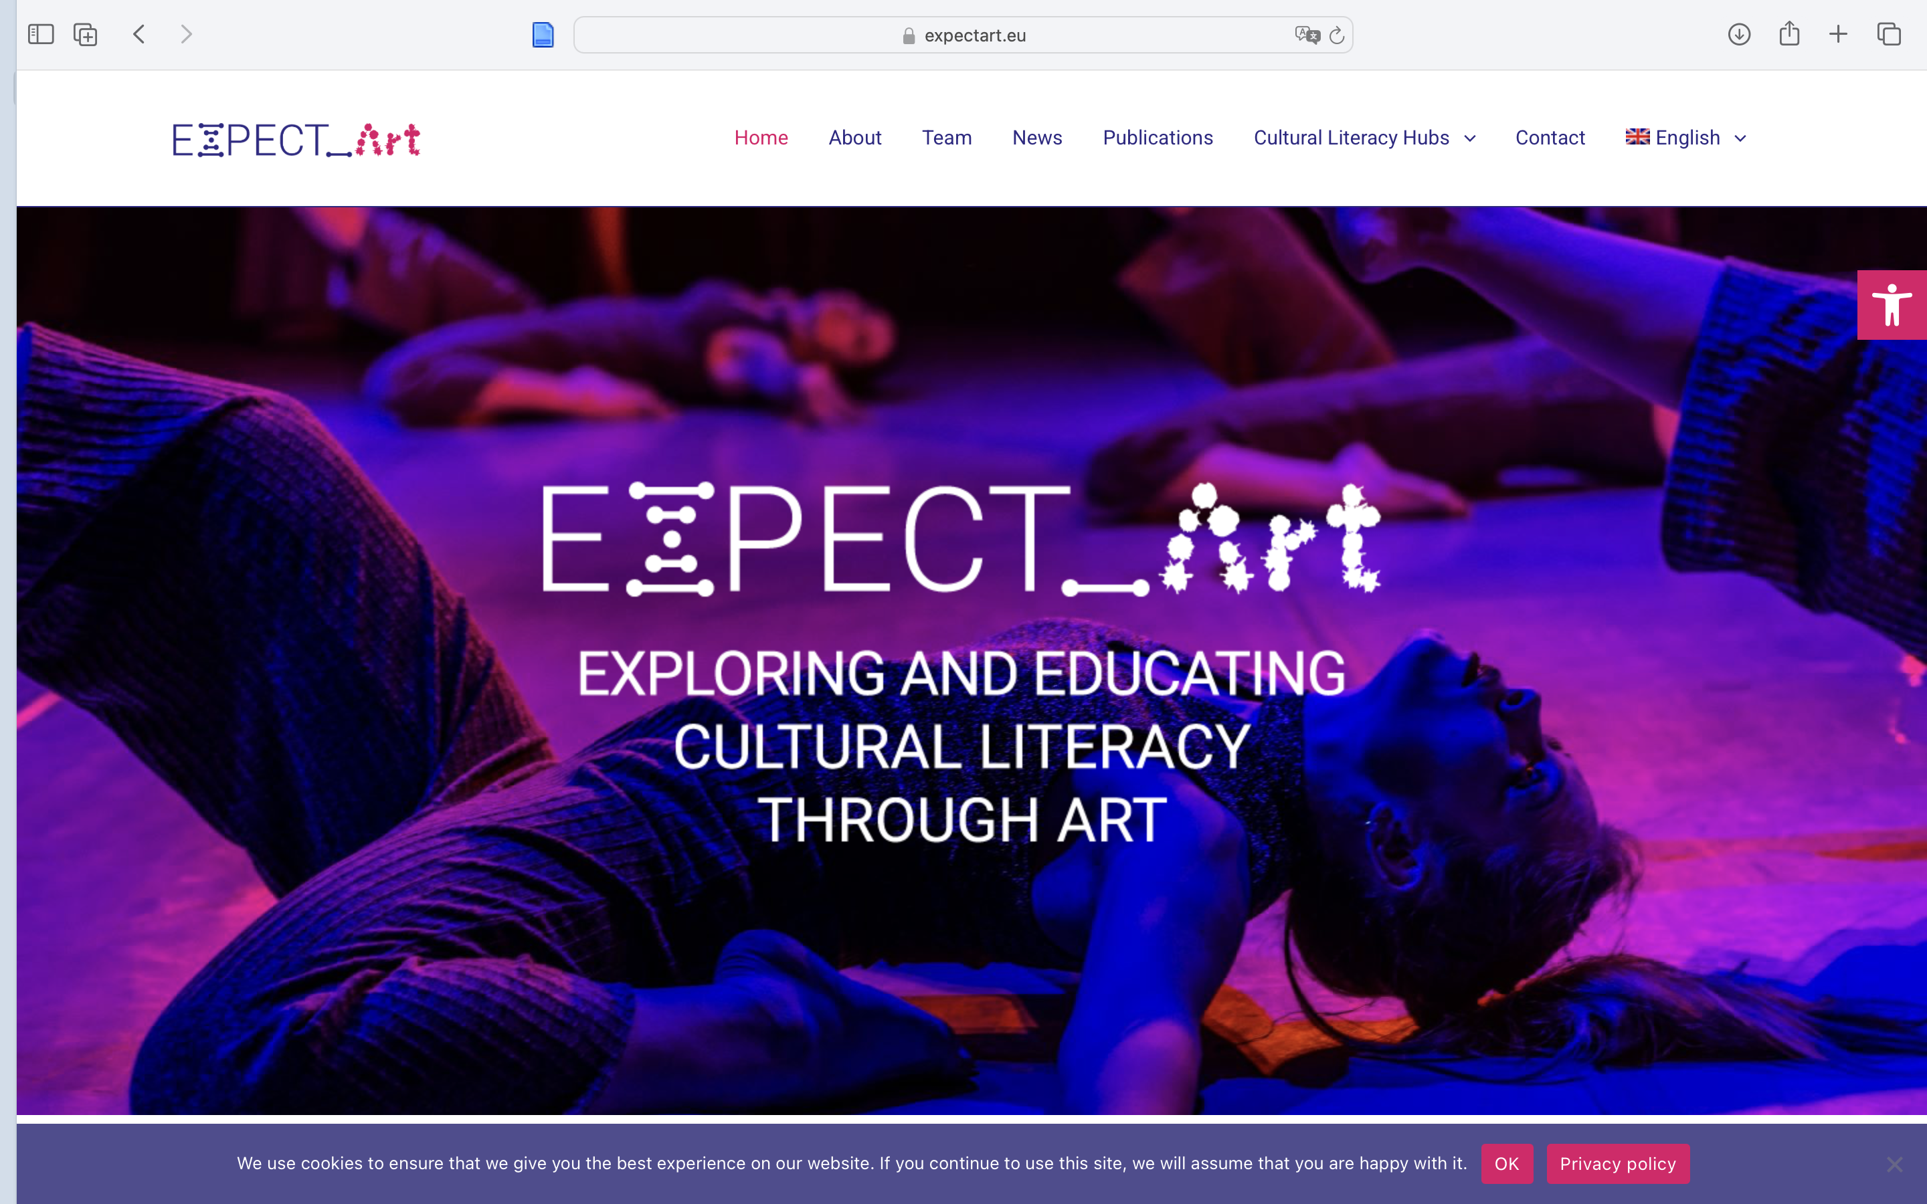
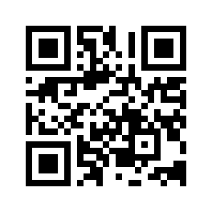
Thank you!
Visit us on: https://www.expectart.eu
Funded by the European Union. Views and opinions expressed are however those of the author(s) only and do not necessarily reflect those of the European Union or European Research Executive Agency (REA). Neither the European Union nor the granting authority can be held responsible for them.

