Slide 1


Gender equality in education
legal aspects and framework
Klaudia Kaptur
Uniwersytet Wrocławski
Community-Based Research, Decolonial Theory and Education
Challenges and Opportunities
Budapest, 4th of June 2025

Slide 2
Definitions:
Gender (versus sex) - The World Health Organisation (WHO) defines gender4 as ‘the characteristics of women and men that are socially constructed, while sex refers to those that are biologically determined’
Gender bias - prejudiced actions or thoughts based on the gender-based perception that women are not equal to men in rights and dignity
Gender identity - each person’s deeply felt internal and individual experience of gender, which may or may not correspond to the sex assigned at birth, including the personal sense of the body (which may involve, if freely chosen, modification of bodily appearance or function by medical, surgical or other means) and other expressions of gender, including dress, speech and mannerisms.
Gender equality - equal visibility, empowerment, responsibility and participation for both women and men in all spheres of public and private life. It also means an equal access to and distribution of resources between women and men
Gender equity - refers to the fairness and justice in the distribution of benefits and responsibilities between women and men. The latter concept recognizes that women and men have different needs and power, and that these differences should be identified and addressed in a manner that rectifies the imbalance between the sexes
Gender stereotype - a generalised view or preconception about attributes or characteristics, or the roles that are or ought to be possessed by, or performed by, women and men…. By reason only of her or his membership in the social group of women or men.
Source: European Commision, Working Group on Equality and Values in Education and Training Issue paper on Gender Equality in and through Education

Slide 3
COMMUNICATION FROM THE COMMISSION TO THE EUROPEAN PARLIAMENT, THE COUNCIL, THE EUROPEAN ECONOMIC AND SOCIAL COMMITTEE AND THE COMMITTEE OF THE REGIONS
A Union of Equality: Gender Equality Strategy 2020-2025
The promotion of equality between women and men is a task for the Union, in all its activities, required by the Treaties.
Gender equality is a core value of the EU, a fundamental right and key principle of the European Pillar of Social Rights. It is a reflection of who we are. It is also an essential condition for an innovative, competitive and thriving European economy. In business, politics and society as a whole, we can only reach our full potential if we use all of our talent and diversity.
Gender equality brings more jobs and higher productivity – a potential which needs to be realised as we embrace the green and digital transitions and face up to our demographic challenges.

Slide 4
A Union of Equality: Gender Equality Strategy 2020-2025
The implementation of this strategy will be based on the dual approach of targeted measures to achieve gender equality, combined with strengthened gender mainstreaming.
The Commission will enhance gender mainstreaming by systematically including a gender perspective in all stages of policy design in all EU policy areas, internal and external.
The strategy will be implemented using intersectionality – the combination of gender with other personal characteristics or identities, and how these intersections contribute to unique experiences of discrimination – as a cross-cutting principle
‘Intersectionality’ (EIGE definition) - an “analytical tool for studying, understanding and responding to the ways in which sex and gender intersect with other personal characteristics/identities, and how these intersections contribute to unique experiences of discrimination”

Slide 5
Convention on the Elimination of All Forms of Discrimination against Women
Article 10: States Parties shall take all appropriate measures to eliminate discrimination against women in order to ensure to them equal rights with men in the field of education and in particular to ensure, on a basis of equality of men and women:
(a) The same conditions for career and vocational guidance, for access to studies and for the achievement of diplomas in educational establishments of all categories in rural as well as in urban areas; this equality shall be ensured in pre-school, general, technical, professional and higher technical education, as well as in all types of vocational training;
(b) Access to the same curricula, the same examinations, teaching staff with qualifications of the same standard and school premises and equipment of the same quality;
(c) The elimination of any stereotyped concept of the roles of men and women at all levels and in all forms of education by encouraging coeducation and other types of education which will help to achieve this aim and, in particular, by the revision of textbooks and school programmes and the adaptation of teaching methods;
(d ) The same opportunities to benefit from scholarships and other study grants;
(e) The same opportunities for access to programmes of continuing education, including adult and functional literacy programmes, particulary those aimed at reducing, at the earliest possible time, any gap in education existing between men and women;
(f) The reduction of female student drop-out rates and the organization of programmes for girls and women who have left school prematurely;
(g) The same Opportunities to participate actively in sports and physical education;
(h) Access to specific educational information to help to ensure the health and well-being of families, including information and advice on family planning.

Slide 6
European Convention on Human Rights
Article 2 (Protocol no. 1) - Right to education:
No person shall be denied the right to education. In the exercise of any functions which it assumes in relation to education and to teaching, the State shall respect the right of parents to ensure such education and teaching in conformity with their own religious and philosophical convictions.

Slide 7
Council of Europe Convention on preventing and combating violence against women and domestic violence (CETS No. 210)
Article 14 – Education
1. Parties shall take, where appropriate, the necessary steps to include teaching material on issues such as equality between women and men, non-stereotyped gender roles, mutual respect, non-violent conflict resolution in interpersonal relationships, gender-based violence against women and the right to personal integrity, adapted to the evolving capacity of learners, in formal curricula and at all levels of education.
2. Parties shall take the necessary steps to promote the principles referred to in paragraph 1 in informal educational facilities, as well as in sports, cultural and leisure facilities and the media

Slide 8
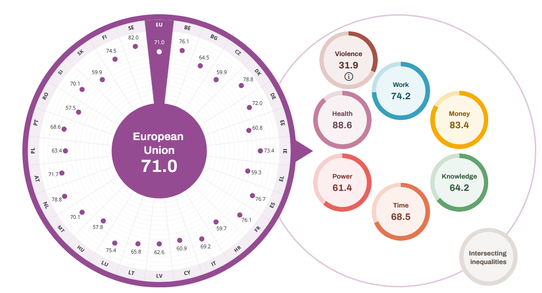
2024 Summary on Gender Equality
14 of the top 20 countries worldwide on gender equality are EU Member States
However, no Member State has achieved full gender equality and progress is slow.
While the gender gap in education is being closed, gender gaps in employment, pay, care, power and pensions persist.
Gender Equality Index (2024)
Source: https://eige.europa.eu/gender-equality-index/2024

Slide 9
Bibliography
H. Dębska, Iluzje prawniczego rozumu. O społecznych warunkach praktyk (bez)refleksyjnych, studia prawno-ekonomiczne, Kraków 2014.
B. Van Driel, V. Donlevy, M. Melstveit Roseme, Issue paper on Gender Equality in and through Education, Publications Office of the European Union, 2023.
European Commision, A Union of Equality: Gender Equality Strategy 2020-2025
European Convention on Human Rights
Convention on the Elimination of All Forms of Discrimination against Women
Council of Europe Convention on preventing and combating violence against women and domestic violence (CETS No. 210)
S. Spurek [w:] Konwencja o zapobieganiu i zwalczaniu przemocy wobec kobiet i przemocy domowej. Komentarz, wyd. II, red. E. Bieńkowska, L. Mazowiecka, Warszawa 2024, art. 14
K. Sękowska-Kozłowska, Między obowiązkiem a przyzwoleniem. Środki wyrównawcze na rzecz kobiet jako instrument realizacji praw człowieka, Warszawa 2021

