Slide 1

Decolonisation in Eastern Europe: Curriculum, Local Relations, and Drama Pedagogy in a Roma-Majority School in Hungary
Zsuzsanna Vidra, Lilla Eredics, Ágnes Kende, Zsuzsanna Árendás
HUN-REN Centre for Social Sciences
Conference ’ Decentering through Arts-based and Participatory Research Approaches’, June 4, 2025, Budapest.

Slide 2
Decolonizing the curriculum
Centralized curriculum - conservative and nationalistic
minority representation possible only in the standardized way (“Népismeret” - usually for only Roma, not intercultural education)
where is the place for artistic interventions? where the place for critical pedagogy? how does decolonization play out in this context?
how is this place can be inhabited?
Two case studies:
1. Drama club - local Roma teacher
2. Insite drama

Slide 3
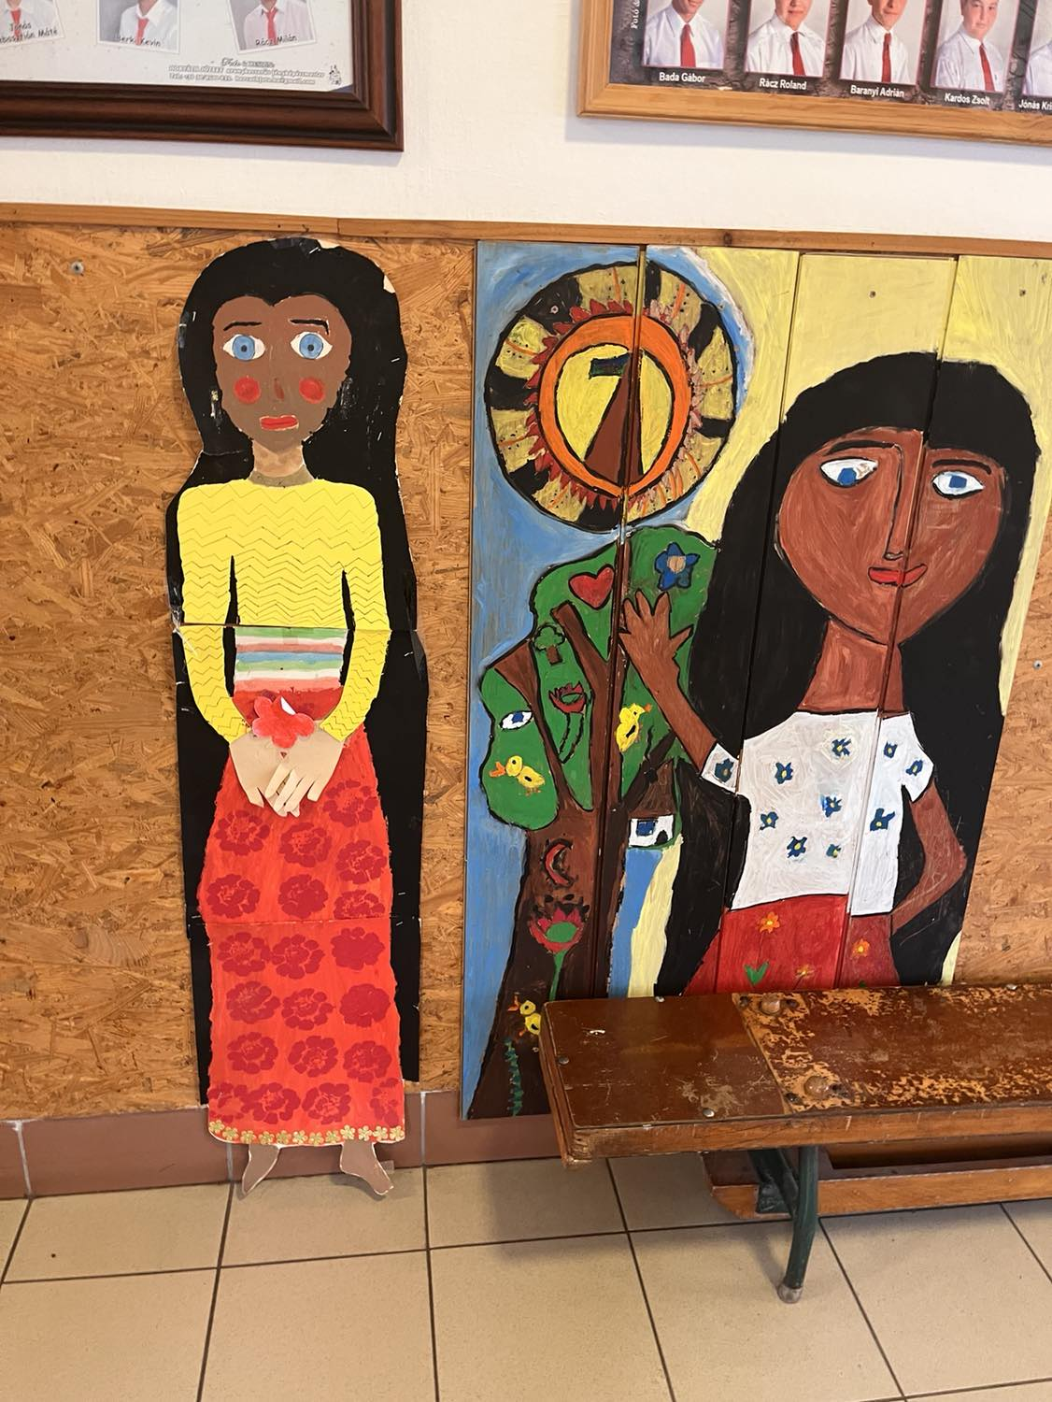
Decolonization- recolonization
Roma folklore class
Minority curriculum: history, traditions, folklore, language
“canonized” Roma culture, normalized and standardized by the Roma elite in Hungary
How does it work in the class
Projects, lived culture, identity project, Roma cultural literacy

Slide 4
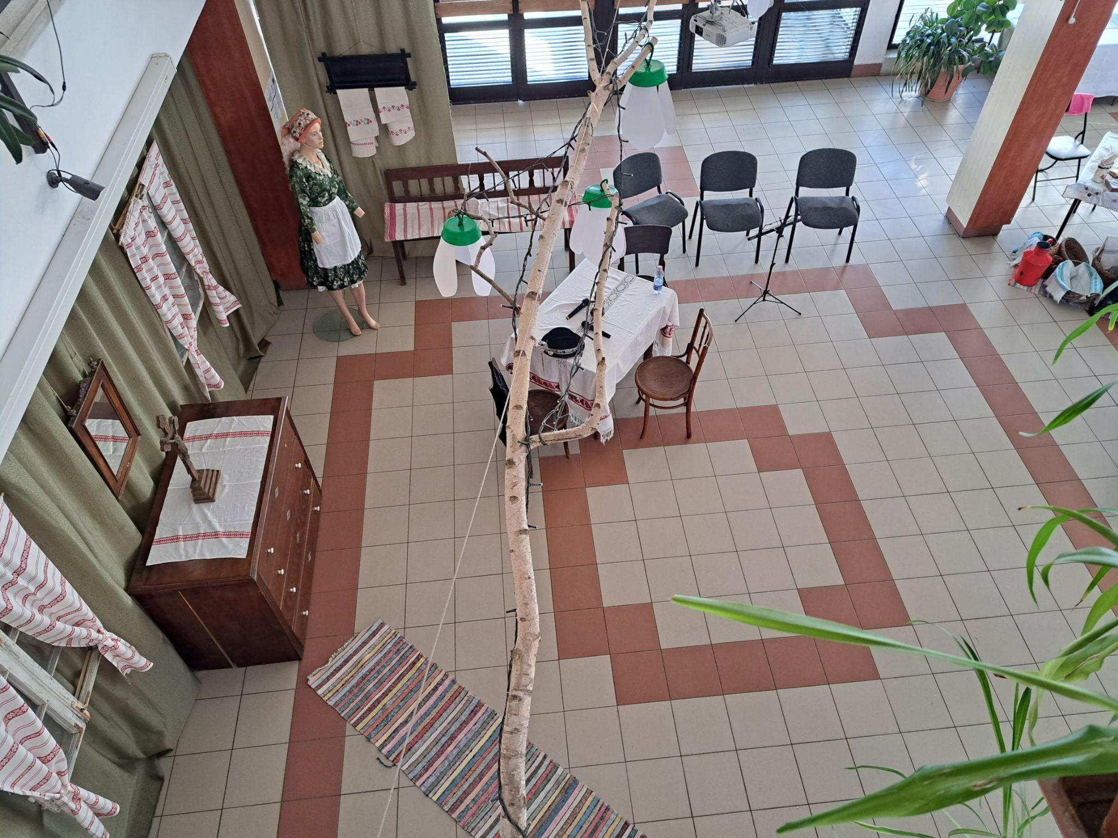
centralized curriculum
example:
regionally organized
competition on Palóc folk
culture
Nothing about Roma

Slide 5
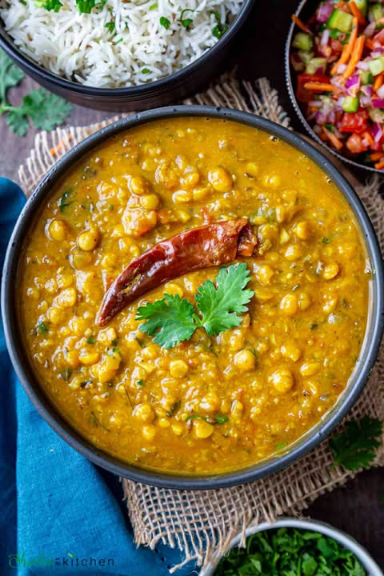
where is the local community? local heritage, positionalities, tastebuds
positionality- building raport with the locals
cooking as a shared activity, sharing life experiences, stories, getting to know about each other, being curious about each other
food as an object, as talking directly to bodily sensations, taste and smell, taste as a cultural construct, conversing about issues related to taste, heritage
using an exotic food as a smokescreen to talk about “others”, shifting a focus, unothering the Roma, shifting the boundaries of us/ them
topics: employment, health, opportunities or lack of them, heritage repositioned

Slide 6
1.Drama club
Roma teacher shifted her drama club to be Roma themed
8.03-8.20
https://www.youtube.com/watch?v=WSwA_SP7pfQ
István, a király iskolába megy... KOPPÁNY VEZÉR - Karancssági I. István Általános Iskola
same teacher: “bring your animal” project (chickens, pigs, horse, goat, etc.)

Slide 7
1.Drama club - personal experiences of racialization and discrimination
Local Roma drama teacher:
For me, they (her parents) left for work at 4:30, the alarm was on because there was no phone then. Now we've got to get up at 7 because we're going to school. Anyway, I got up on my own, and then I didn't want to be a food vendor, and I had an experience there for two years where they (classmates) opened the window for me, I was the only gypsy in the class of 35, and it wasn't common then to hire people of Roma origin as food vendors. And then they opened the window for me …and so the gypsy came.

Slide 8
1. Drama club - personal inspiration Roma heritage
“Gypsy tradition” - elopement of the bride, happened to her grandmother
I'm preparing for a competition with them now, a talent contest, and I'll be honest, it's inspired by my grandmothers. … we revived gypsy folk traditions. I played the Roma elopement with the children. Two of the stories my grandmother and my grandfather used to tell us. …

Slide 9
1.Drama club - method
Local Roma teacher:
I'm doing the play with the children. So it's my opinion how they think we should put this in. …So you know, I don't have a script, I improvise everything with the children. …They know the basic story, I tell them what I expect, I help them with how they should emotionally present it, but the text itself.

Slide 10
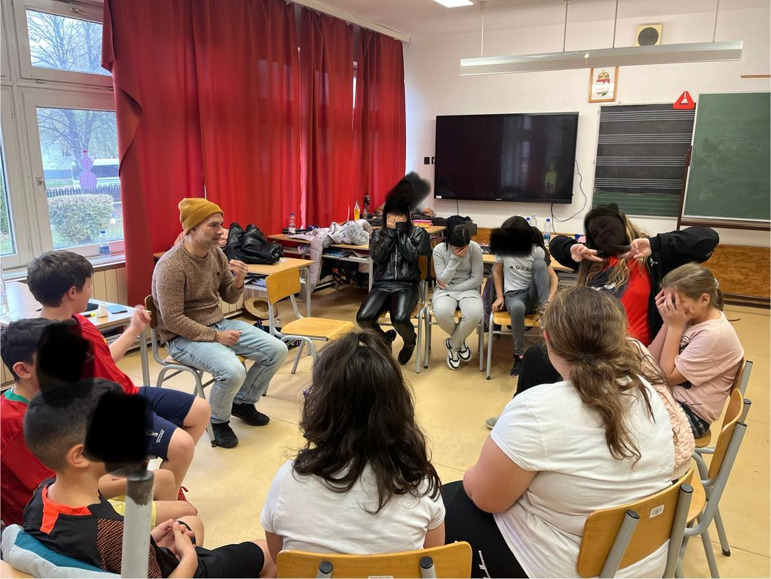
2.Insite drama
follows the literature
curricula with drama pedagogy methods
attentive and receptive to the dynamics, mood, “language” and cultural codes of the class
reflects upon how to express
emotions and connect to children’s reality
methods: music, rap, drama, improvisation
Drama teacher brings in his personal story
He is Roma which is stated and important part of the class (establishing rapport with children, common voice, trust)

Slide 11
2.Insite drama (fieldnote excerpt)
Kristóf opens the class by asking: Why or when do we love theatre or drama? In their answers, the children mostly emphasize that a drama is good “if someone dies at the end.” Kristóf doesn’t steer the conversation away from this but rather connects to it and probes further: What do you feel when that happens? The children list emotions such as “surprise, disappointment, heartbreak, depression.” Giving recognition to these answers Kristóf shares his opinion: drama can help us experience difficult emotions that are also present in real life, but are often hard to express.
As Kristóf continues asking the children about the characteristics of good dramas, someone mentions that there should also be “handsome guys” in them. Kristóf incorporates this into the discussion as well: Why are we happy when we like someone? What happens inside us in such moments? In connection with the question, he anticipates possible responses, aiming to prevent the children from turning each other’s emotions into targets: “I ask you to observe yourselves, not to make this class about teasing each other.”

Slide 12
Conclusions and questions
Centralized curriculum - colonizing
Can it be decolonized in the context of a full-Roma school?
two processes:
-recolonization of Roma culture (aligning with the mainstream expectations) BUT
-decolonization also taking place
decolonizing Roma experiences and identities (Roma teachers’ personal paths)
decolonization as a way of navigating the system - experimentiing with methods
- much like critical pedagogy
How do artistic methods shape schooling experience of children of a marginalized community?
Does it contribute to the pacification of a deprived (and potentially angry) community?
Is the a “good school” or an “illusion of a good school”?

