Slide 1



FILM AS A MEDIUM TO ADDRESS DISCRIMINATION
Contrasting Pedagogical Approaches in a Participatory Project on Cultural Education in German and Slovenien Classrooms
Bianca Baßler¹, Fenna tom Dieck¹, Zorana Medaric², Lisa Rosen¹, Maja Zadel²
¹Rheinland-Pfälzische Technische Universität Kaiserlautern-Landau,
²Science and research centre Koper
Paper presented at International Academic Conference Reimagining Local Communities – Law, Administration and Culture
Wrocław, May 19, 2025 (online)

Slide 2
Table of content
Introduction
Theoretical Framework
Methodological Framework
Case Studies
Conclusion & Outlook
Discussion

Slide 3
Introduction
Short introduction to the EXPECT_Art project (January 2024-December 2026)
Aim of the presentation: to present the first steps of the analysis of the comparison of two film-based educational approaches in Germany and Slovenia within a participatory research framework.
Guiding question: Which pedagogical approaches towards critical cultural literacy via film can be comparatively explored in case studies of German and Slovenian Classrooms?

Slide 4
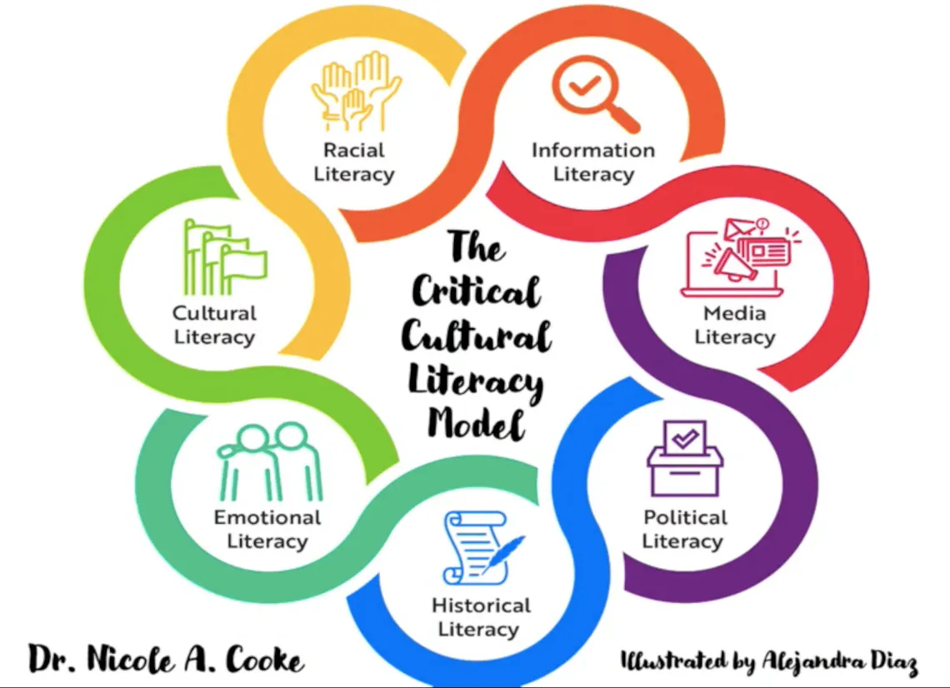
Theoretical Framework
„... critical literacy challenges the status quo to discover alternative pathways for social and self-development. Critical literacy aspires to ensure social, political, and emancipatory inclusion for all individuals and groups of individuals within any given society" (https://www.expectart.eu/wp-content/uploads/2024/11/241030_Deliverable-2.1.pdf, p. 17)
source: https://ic4ml.org/journal-article/the-critical-cultural-literacy-model/

Slide 5
Methodological Framework
Evolving comparative perspectives in the current project phase:
Contrasting analyses of excerpts from key incidents (Sindberg Jensen & Hobel 2020) from two case studies
Drawing on ethnographic data and verbal transcripts from classroom observations during the first and early stages of second field phase in the project
Comparative perspectives: Cases and contexts are understood as dynamic and contingent results of casing, not as pre-defined entities based on spatio-geographical classifications (Parreira do Amaral 2021)

Slide 6
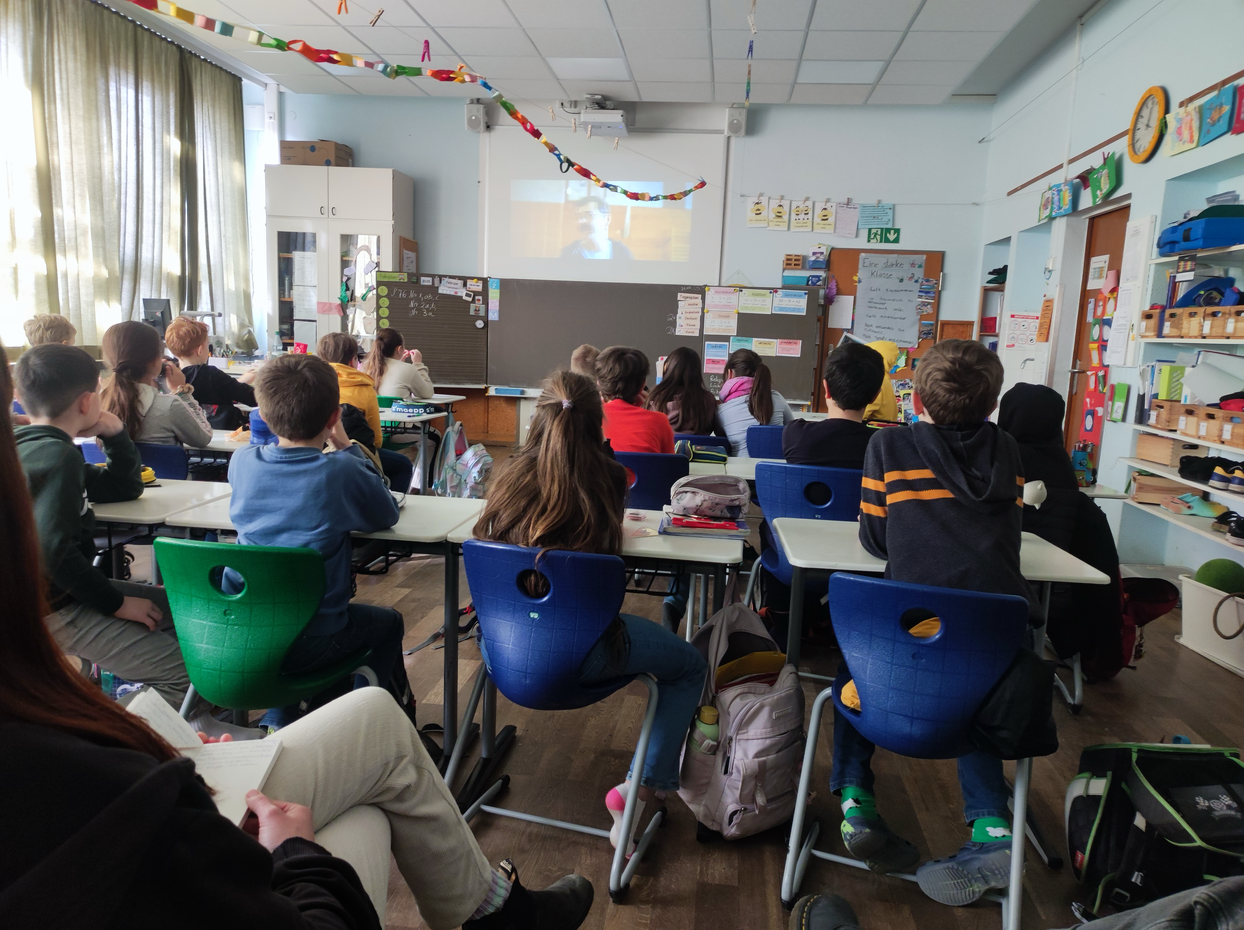
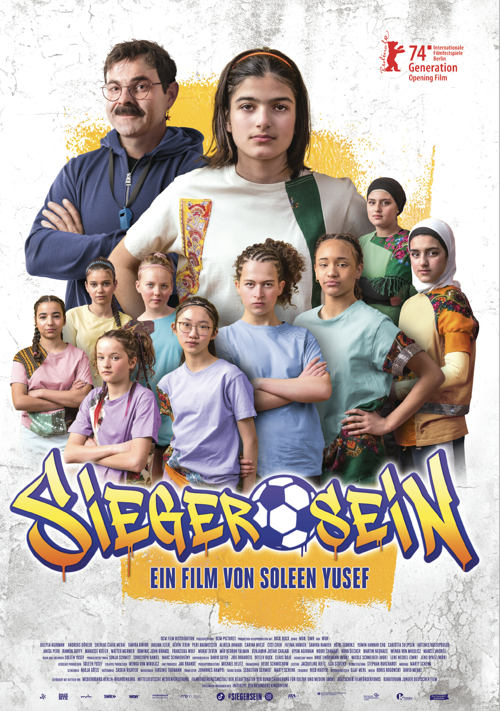
Case Study 1:
Germany
Film screening in the classroom, 21.02.2025

Slide 7
Case Study 1:
Kimlotte says that she wants to give the children a content note for the upcoming film. Some students show interest and ask what it means. Kimlotte explains: ‘It's something you should know before watching a film’ and adds ‘because the film is also about war.’ A student adds ‘and about bullying,’ which Kimlotte picks up on and confirms. She adds: ‘and above all about racism.’ When Kimlotte asks about the term racism, the students respond very actively. Many raise their hands to share their knowledge, while others point out that they know the term from religious education. […] The discussion expands to include other forms of discrimination. A student brings up the concept of disability, whereupon Kimlotte explains the distinction between racism and ableism. […] Poverty is also discussed as a possible form of discrimination. One student brings up the idea that wearing glasses can lead to exclusion. Kimlotte explains the difference between bullying and racism.

Slide 8
Case Study 1:
Then Kimlotte explains: ’Well, these two topics are addressed a lot in the film. And I want to say that if it somehow makes you either sad or you feel it's just too much for you, then you come to one of us three and then we just go outside. Last time we watched the film with a class in sixth grade, someone wanted to leave. And it's quite natural that sometimes films bring up things in you, that touch you very much, or that it's just too much at that moment. And that's quite normal and I think it's very, very strong when you realise that it's too much for me now. I don't want to see this information right now. When you realise that, whether it's a horror film or here in class today, it's always good to say, ‘That's too much for me right now. I'd rather go out now. OK?’ And I'd like you to do that in any case when you realise that.’
The teacher underpins this statement with a personal example, whereupon a student openly expresses that she has cried during a film before, while another student distances himself from this. The discussion ends with the teacher confirming that feelings are different and that everyone is allowed to react in their own way: ‘And if you cry, then you cry, that's okay too’.

Slide 9
Case Study 2: Slovenia
Context: Screening of A Small Step for a Man, a Big Smile for Humankind (2016) - documentary film prepared by the Elementary school Bičevje in Slovenia
Shown during a series of workshops in the class "Homeland and civic culture and ethics class", 7th grade, (12-13 years old pupils)

Slide 10
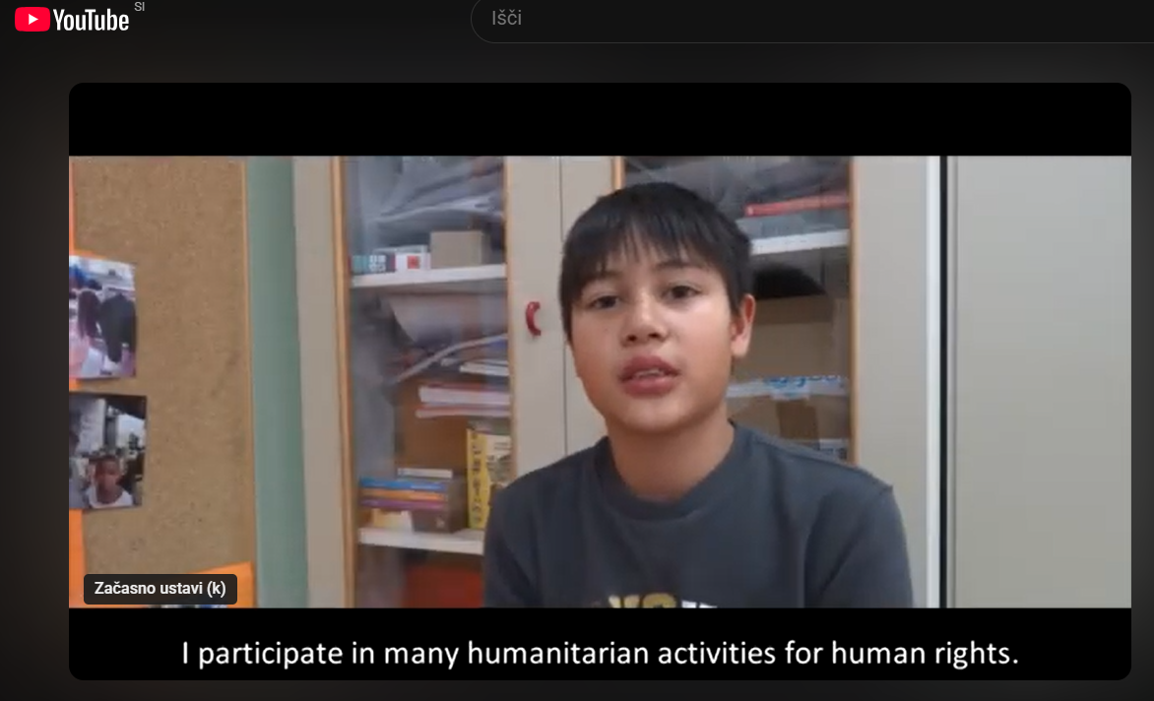
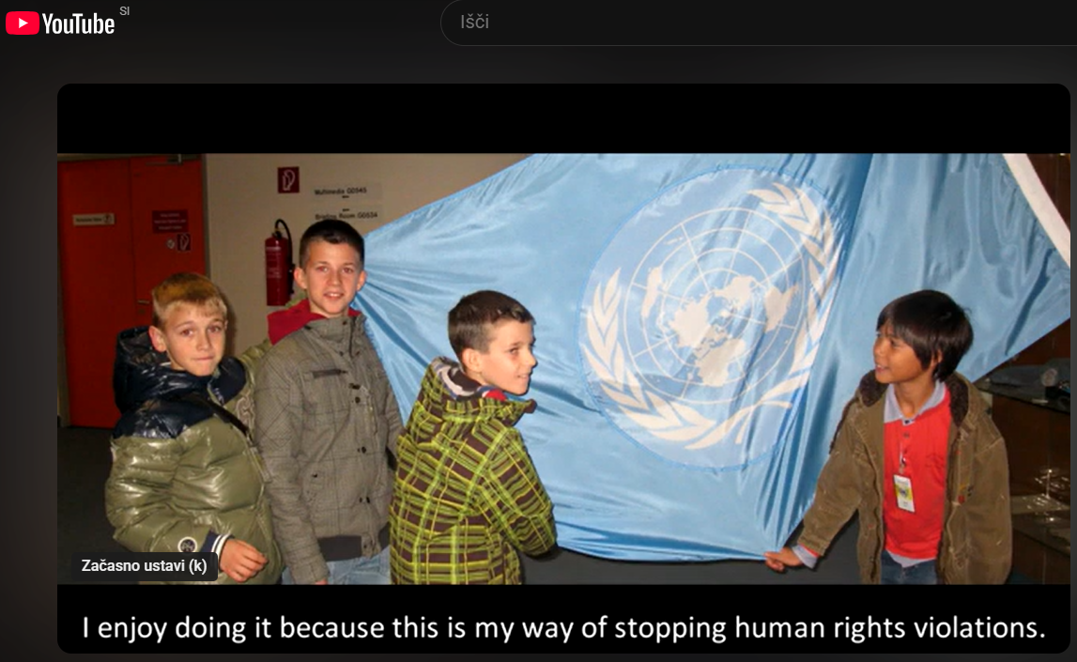
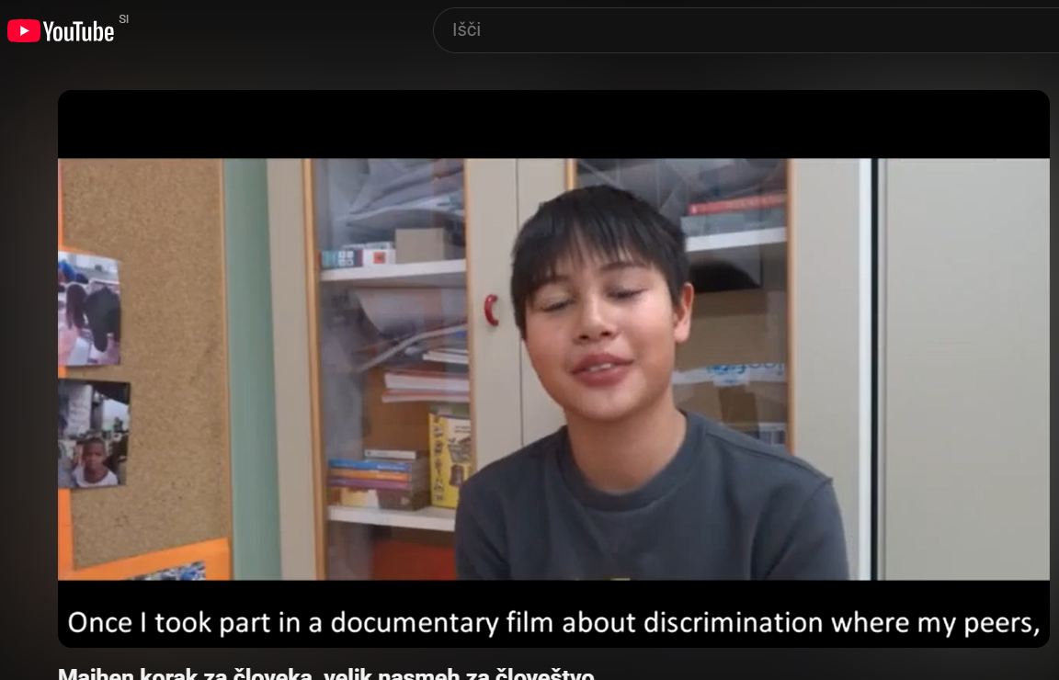
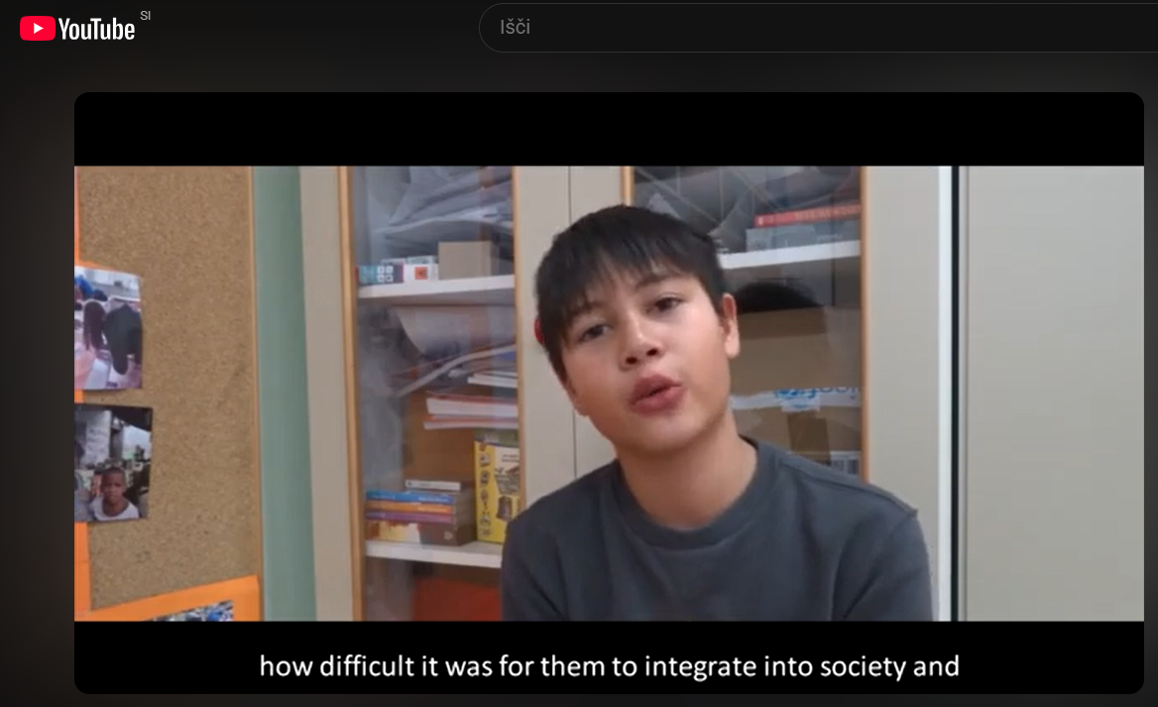
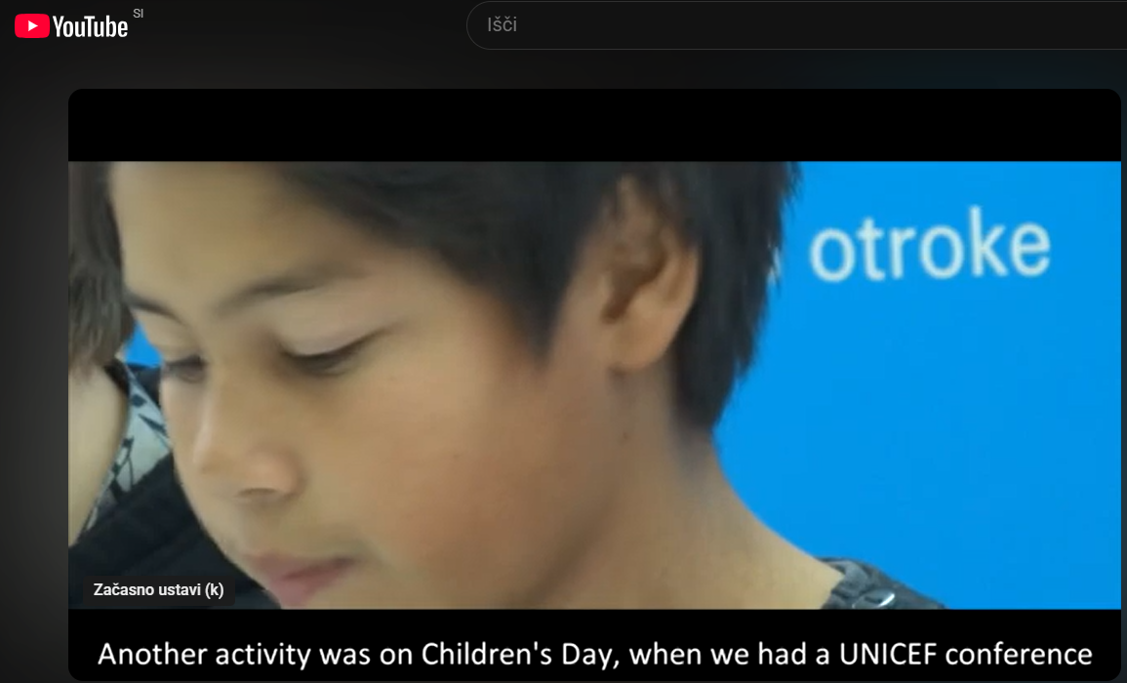
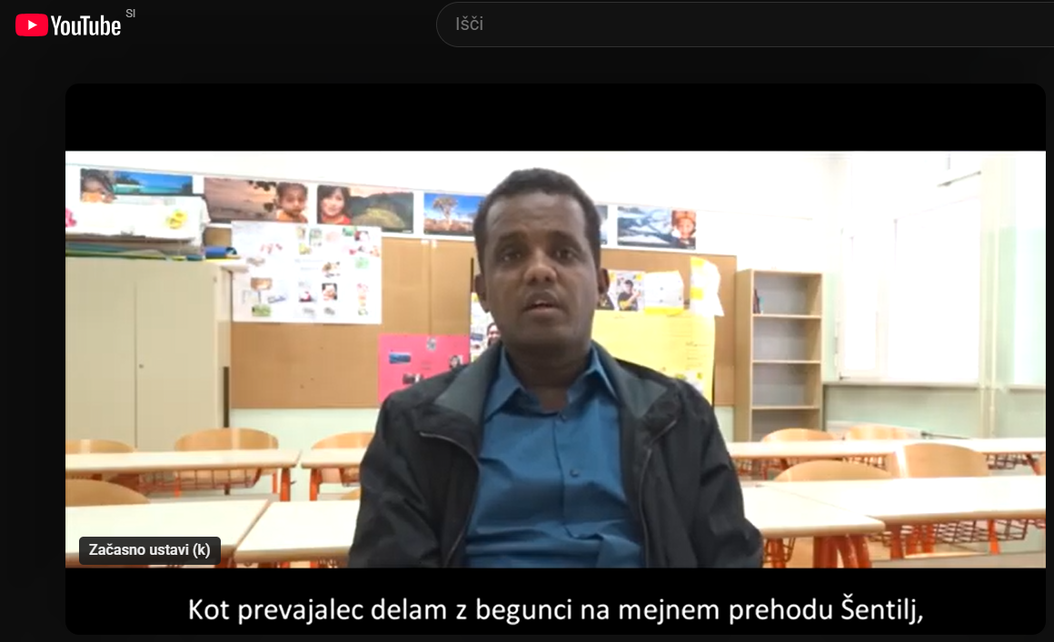
Case Study 2: Slovenia

Slide 11
Case Study 2: Slovenia
The teacher again stops the movie and asks them if they heard what he said what are the discharges of hydrogen buses and the children say that it is water. “In which form”? Do you know that the formula of the water is H2O?” Because children are constantly chatting a boy shouts in between: “Can you please be quiet!” “So which aggregate state is the water in?” “In the form of steam”, somebody says. […] Then there is a movie frame showing bees on lavender. The teacher asks: “Which plant is this?” Children reply: “lavender”. The man in the movie explains that the plants are important for pollination – everything bees, birds, insects gains something from green areas in the city. […] Later there is a boy in school who presents his activities in different actions. He talks that they discussed discrimination, how difficult it is to adjust to a new environment for migrants, who often travel through different countries without basic necessities, water for drink or cleaning clothes, bed, roof over the head. […] He talks about human rights and that it is not right that refugees don’t have any human rights.

Slide 12
Case Study 2: Slovenia
The story that follows is presented by a Somalian man who moved to Slovenia and is now a translator for the asylum seekers. One of the boy shouts: “Look, it’s Aleksej” (This is their schoolmate). Since the teacher did not react Boy1 said: “Teacher, Boy2 said that this dark-skinned guy is Aleksej!” I was watching if teacher would take this opportunity to discuss the issue of stereotypes, inequalities, discrimination or any topic related to the multiculturality, but she did not […] The Somalian man continues and explains that he is collaborating with HUMANITAS, a society that offers workshops on global learning, raising awareness about migration among teachers and students.
First analysis: Limited focus on discrimination, no preparatory pedagogical framing - Missed opportunity for deeper engagement with social power relations

Slide 13
Conclusion and Outlook

Slide 14
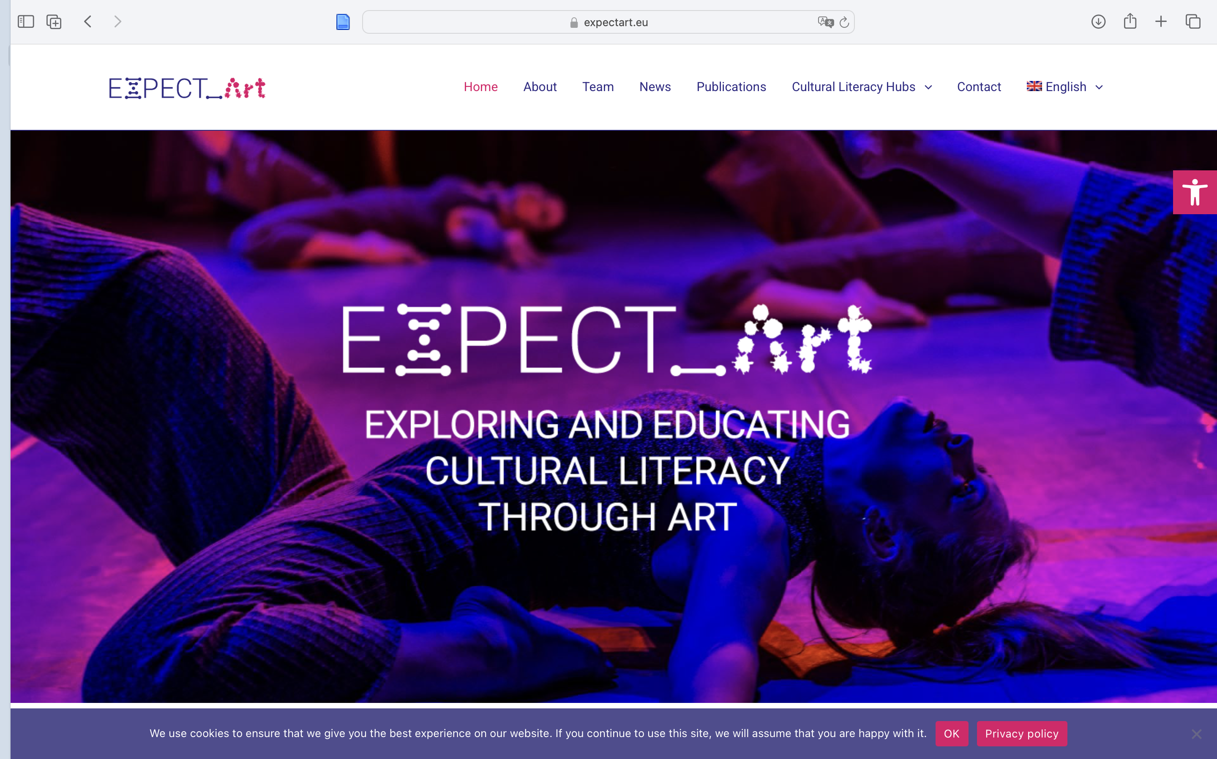
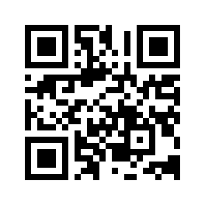
Thank you!
Visit us on: https://www.expectart.eu
Funded by the European Union. Views and opinions expressed are however those of the author(s) only and do not necessarily reflect those of the European Union or European Research Executive Agency (REA). Neither the European Union nor the granting authority can be held responsible for them.

Slide 15
Discussion

Slide 16
Literature
Afeworki Abay, R., & von Unger, H. (2024). Cultural humility in participatory research: Debunking the myth of „hard-to-reach“ groups. In R. Afeworki Abay & K. Soldatić (Eds.), Intersectional Colonialities: Embodied Colonial Violence and Practices of Resistance at the Axis of Disability, Race, Indigeneity, Class, and Gender. Routledge. https://doi.org/10.4324/9781003280422
Gallacher, L.-A., & Gallagher, M. (2008). Methodological Immaturity in Childhood Research? Thinking through 'participatory methods'. Childhood, 15(4), 499–516. https://doi.org/10.1177/0907568208091672
Lähdesmäki, T., Baranova, J., Ylönen, S. C. Koistinen, A-K, Mäkinen, K., Juškiene, V. & Zaleskiene, I. (2022). Learning Cultural Literacy through Creative Practices in Schools. Cultural and Multimodal Approaches to Meaning-Making. Springer Nature.
Parreira do Amaral M. (2021). Horizontal, vertical and transversal comparison – Making a case for case studies. Tertium Comparationis, 27(2), 181-196.
Sindberg Jensen, S., & Hobel, P. (2020). Key Incidents in Child-Centred Migration Research: Exploring Methodological and Epistemological Implications of Child–Researcher Interaction. Znanstveno Raziskovalno Sredisce Republike Slovenije. Annales. Series Historia et Sociologia, 30 (4), 575–586.

